Slide 1
Manuals are for Suckers
Using Free Arrows to Generate Program Semantics Directly from Source Code

Slide 2
Outline
The Squishy Part
The Arrow Primer/Review Part
The Part Where We Look at Code

Slide 3

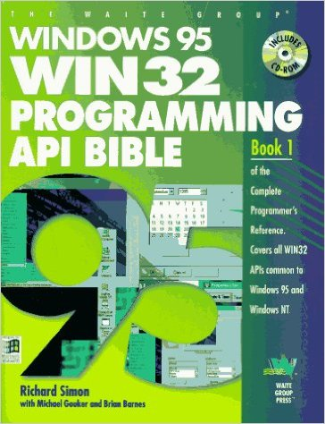
Universal Truths you learn in a Law Firm
Software Developers working in Legal world are expected to oblige
Lawyers like to read stuff !
Notes:
Opening – you learn some important lessons about the universe when you work in at a law firm
1. lawyers like to read stuff
2. developers (at least me) don’t like to write stuff

Slide 4
The Ups and Downs of Working in a Dev-Ops Environment
Test
☹
Code
☺
Deploy
☹
Use
😕
Coders like to code! ☺
Test and Deploy are not fun but can be automated from source code
What about Use?
Someone/something other than the developer does the using
Manuals/training describe the feature
Is there anyway to automate this too?

Slide 5
What if the program itself could describe its functionality?
Mr. Computer,
What sorts of things can you do for me?
Main.hs
xxxxxxxxxxxxxx
xxxxxxxxxxxxxx
featureX :: IO()
xxxxxxxxxxxxxx
Xxxxxxxxxxxxxx
xxxxxxxxxxxxxx
Mr. Computer
Compile
Well, now I can do X.
Here’s what X involves…

Slide 6
Arrows in Brief
Effectful Computations with typed input a and output b
Examples
Pure Functions : (a -> b)
Kleisli arrows : Monad m => (a -> m b)
f
a
b

Slide 7
A Brief History of Arrows
For all their usefulness, monads are limited to a specific kind of library. In this paper [Hughes 00], I introduced a richer and more widely applicable interface, the "arrow" interface, drawing inspiration from category theory…Since I wrote the paper, arrows have turned out to be particularly useful for process-like abstractions. They're used, for example, for functional reactive programming, and are now supported via special syntax in Haskell implementations.
- John Hughes (comments on Generalizing monads to arrows)

Slide 8
Arrows in (slightly more) detail
Operation | Haskell Type Signature | Diagram
Lift | arr :: (b -> c) -> a b c
Composition | (>>>) :: a b c -> a c d -> a b d
Parallel | (***) :: a b c -> a b’ c’ -> a (b, b’) (c, c’)
Split | (+++) :: a b c -> a b’ c’ -> a (Either b b’) (Either c c’)
FanIn | (|||) :: a b c -> a b’ c -> a (Either b b’) c
a
Arrow
a₁
a₂
a₁
a₂
a₁
a₂
ArrowChoice
a₁
a₁

Slide 9
Free Arrows
Free arrows can be put together from other free arrows
and
can be pulled apart again
Not Free as in freedom, Not Free as in beer, Free as in free monad!
a₁
a₂
a₁ >>> a₂

Slide 10
GADT for Free Arrows with Semantic Annotation
data SemanticArrow a eff b c where
Pure :: (b -> c) -> SA a eff b c
Effect :: (eff b c) -> SA a eff b c
Seq :: SA a eff b c -> SA a eff c d -> SA a eff b d
Par :: SA a eff b c -> SA a eff c d -> SA a eff b d
Spl :: SA a eff b c -> SA a eff c d -> SA a eff b d
FanIn :: SA a eff b c -> SA a eff c d -> SA a eff b d
(:?) :: SA a eff b c -> a b c -> SA a eff b c

Slide 11
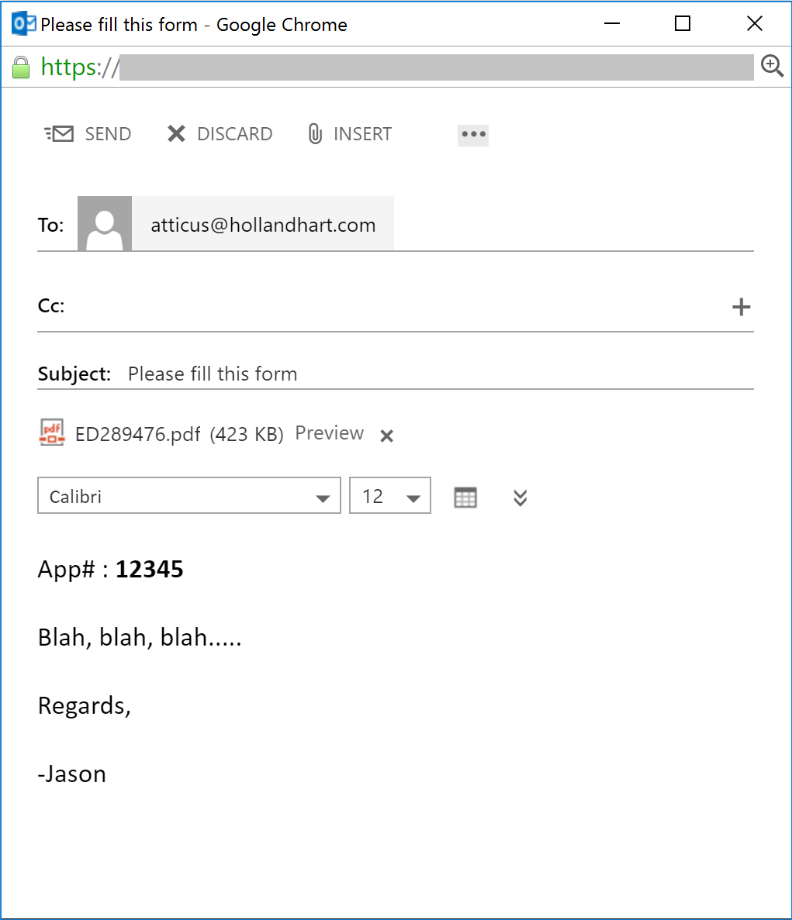
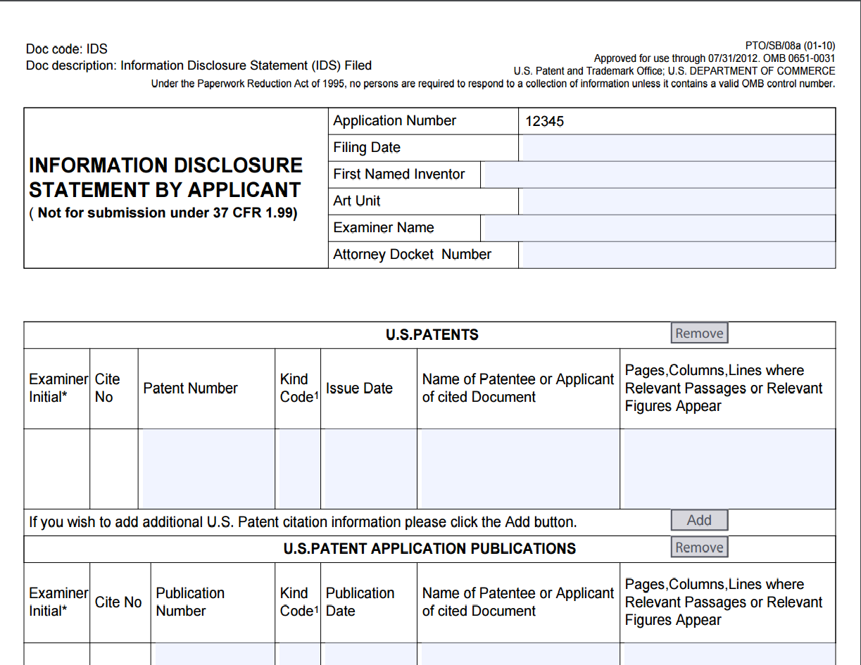
Legal Automation Example (Fill out form)
Email
Form

Slide 12
Legal Automation Example in Haskell

Slide 13
Run a Free Arrow

Slide 14
Run the Example (main)

Slide 15
Run a Free Arrow with Multi-Res Logging

Slide 16
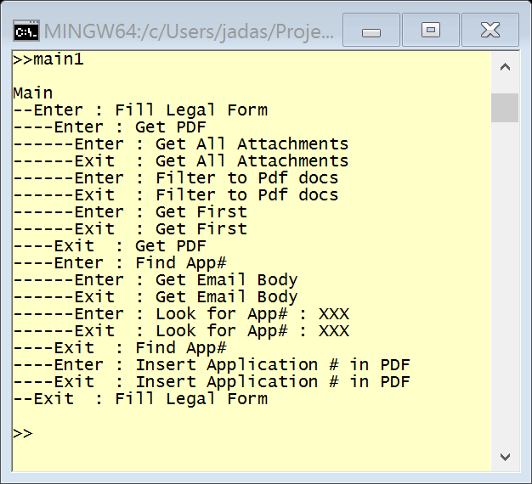
Example with Multi-Res Logging (main1)

Slide 17
Convert Free Arrow to Flowchart w/ GraphViz

Slide 18
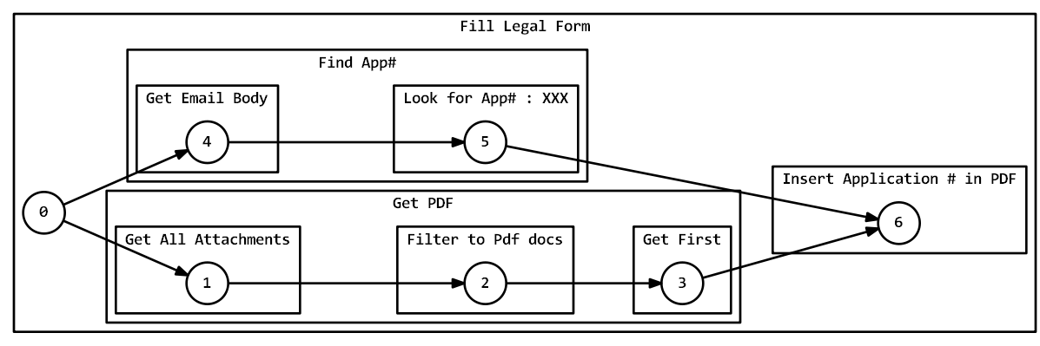
Legal Automation Arrow as a Flowchart (main3)

Slide 19
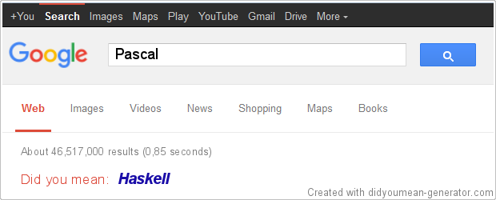
Free Arrows for “Did you mean” for code evaluation
Could we do something like this for automation functionality?

Slide 20
“Did you mean” Context for Example
Multiple automation “routes”
fillLegalForm1
fillLegalForm2
fillLegalForm3
User asks to fillLegalForm1 but actually means fillLegalForm2
Does the provided input “fit” some other route?
Poor man’s solution : gather all errors
fillLegalForm1 : [missing attachment A, missing parameter]
fillLegalForm2 : [incorrect route] *Best Match
fillLegalForm3 : [incorrect route, missing attachment A, missing attachment B]

Slide 21
Gathering Multiple Exceptions

Slide 22
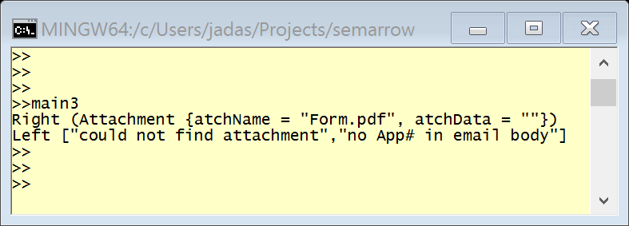
Example with Error Gathering (main3)

Slide 23
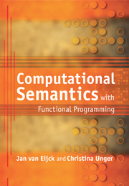
More tricks
Out of band splicing of functionality (AspectJ!?)
Instrument execution w/ logging, security, etc.
Pull out a Pure “prefix”
Extract a subset of functionality
A >>> B >>> C ➔ A >>> C
Model for computational semantics
Create a “database” of functionality
Evaluate predicate logic propositions about code

Slide 24
Special Thanks To
Various SO Saints that helped me turn half-baked ideas into something concrete (phadej, Cactus, Sjoerd Visscher)
LambdaConf 2016 Organizing Committee
Holland & Hart LLP

